Slide 1
LENDER JOURNEY
TRAINING MODULE BRANCH USERS : MAKER

Slide 2
INDEX
1 | AUTO LOAN - DETAILED LENDER’S PROCESS FLOW
2. | CREATING DUE DILIGENCE REPORT - SCREENWISE WALK THROUGH

Slide 3
AUTO LOAN DETAILED LENDER’S PROCESS FLOW

Slide 4
OVERALL PROCESS
Lender
Admin (Maker & Checker)
Branch Maker
Branch Checker
Head Office
Creation of Scoring Model and Scaling Matrix.
Setting up Go-No-Go. Parameters for the Product.
Assessment Method.
Conducting Due Diligence and Final checks on the In-Principle Approved Proposals.
Compiling detailed information of the Borrower and fill the Final Section.
Approving the Due Diligence Report.
Sanction/Hold/Reject the proposals.
Disburse the sanctioned proposal.
Monitoring Proposals at their Branches.
Monitoring Branches Performance.

Slide 5
LENDER JOURNEY
In-principle Approval (Admin)
Setting Purpose of Loan,
Scoring and Product Parameters
Admin Maker creates the Setting Purpose of Loan,
Scoring and Product Parameters
Admin Checker approve the Purpose of Loan, Scoring and Product.
Sanction/ Disbursement (Branch Office)
Borrower’s Proposal Received
Branch Maker accepts the Proposal
Branch Maker Fills the Final Details
Branch Maker sends it to Branch Office Checker
Branch Checker Disburses the Proposal
Branch Checker Accepts/ Rejects / Holds the Proposal
Branch Checker Views the Proposal
Branch Checker Accepts / sends back the Proposal

Slide 6
CREATING DUE DILIGENCE REPORT SCREENWISE WALK THROUGH

Slide 7
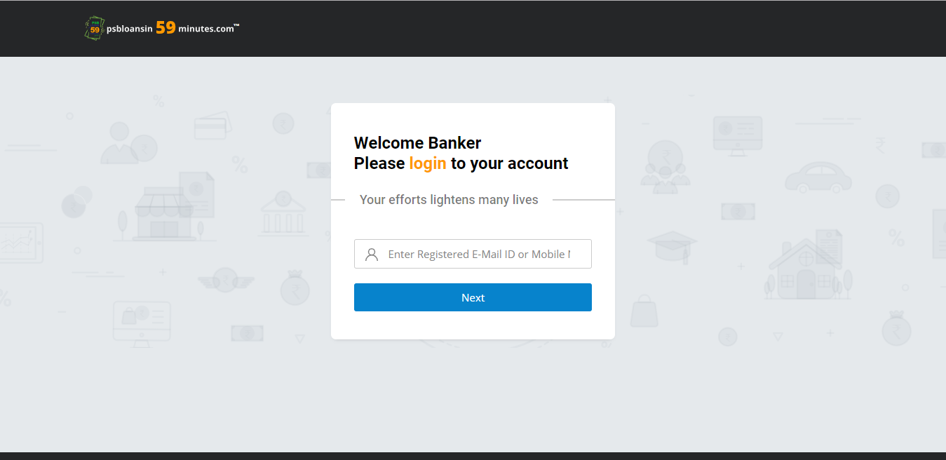
LOGIN
The URL is: https://www.psbloansin59minutes.com/banker

Slide 8
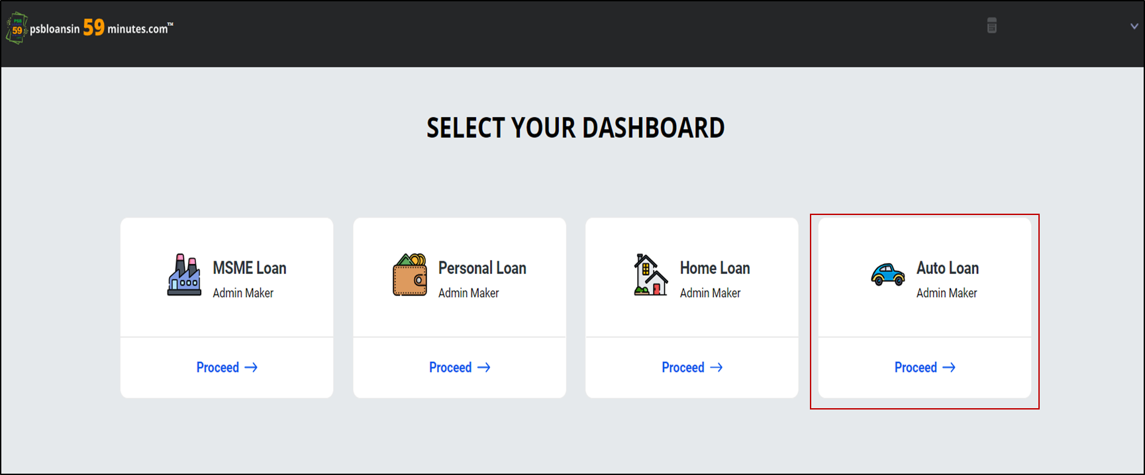
DASHBOARD
Lenders will select the dashboard based on the type of Product that they want to conduct the due diligence.

Slide 9
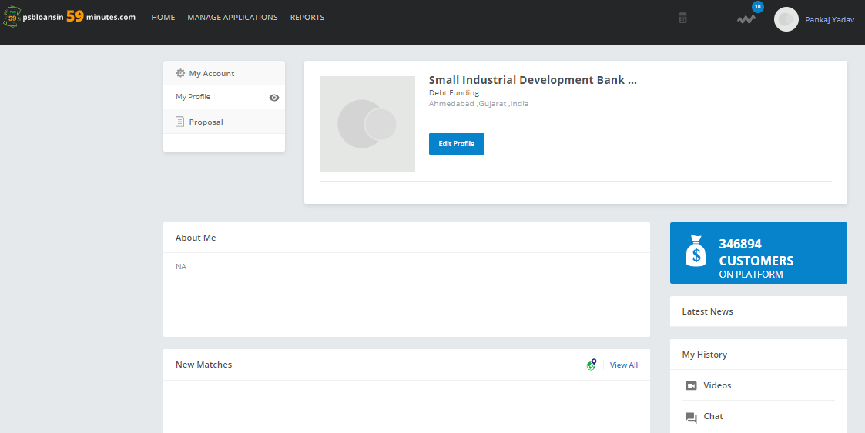
LANDING PAGE
Landing Page for Branch Maker.

Slide 10
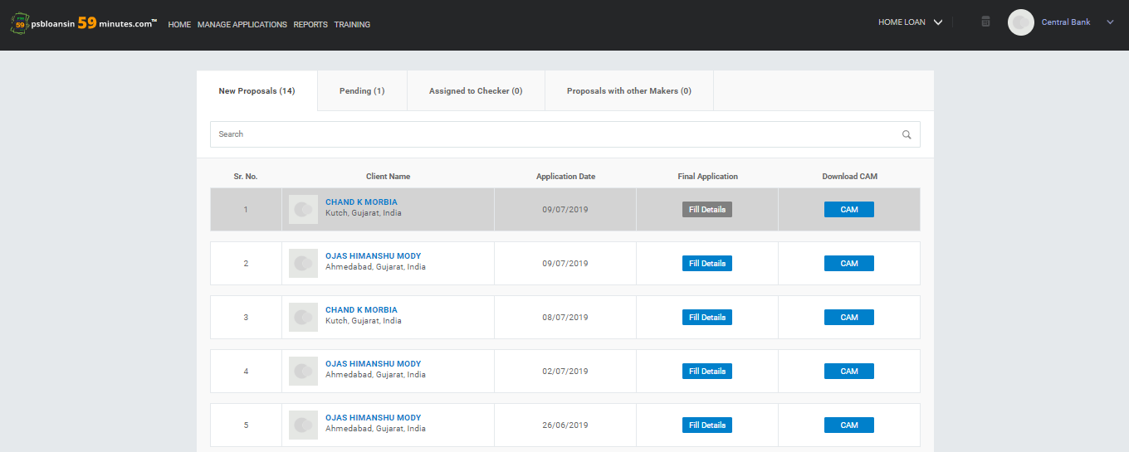

MAKER ACCEPTS PROPOSAL
Click on ‘Manage Applications’ and under ‘New Proposal’ section, Branch Maker can view all Proposals.
Maker can accept the proposal by clicking on 'Fill Details’.

Slide 11
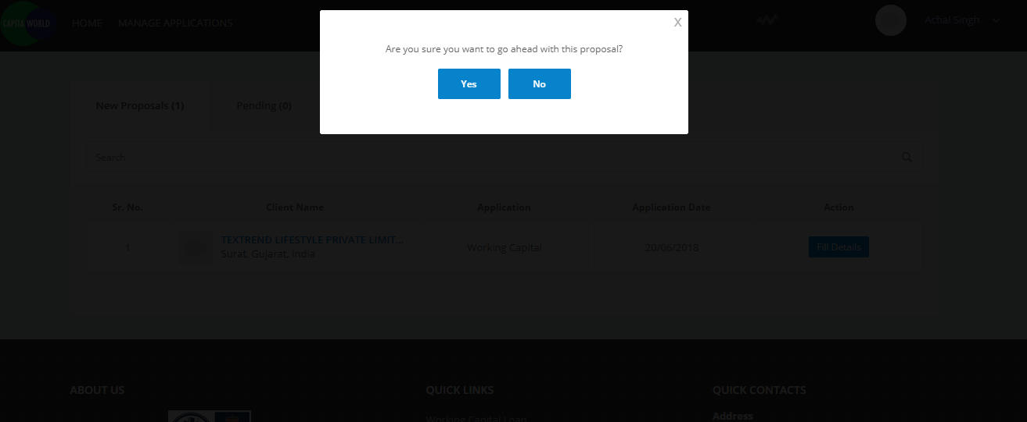
PROPOSAL
On Acceptance of the Proposal, a confirmation pop-up is shown.

Slide 12
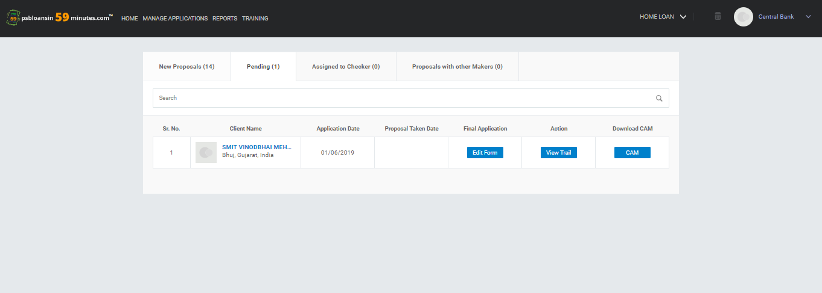
PROPOSAL DETAILS
Once the Maker accepts a proposal, the same proposal shifts to the 'Pending' tab.
Maker can then fill the Form by clicking on ‘Edit Form‘.

Slide 13
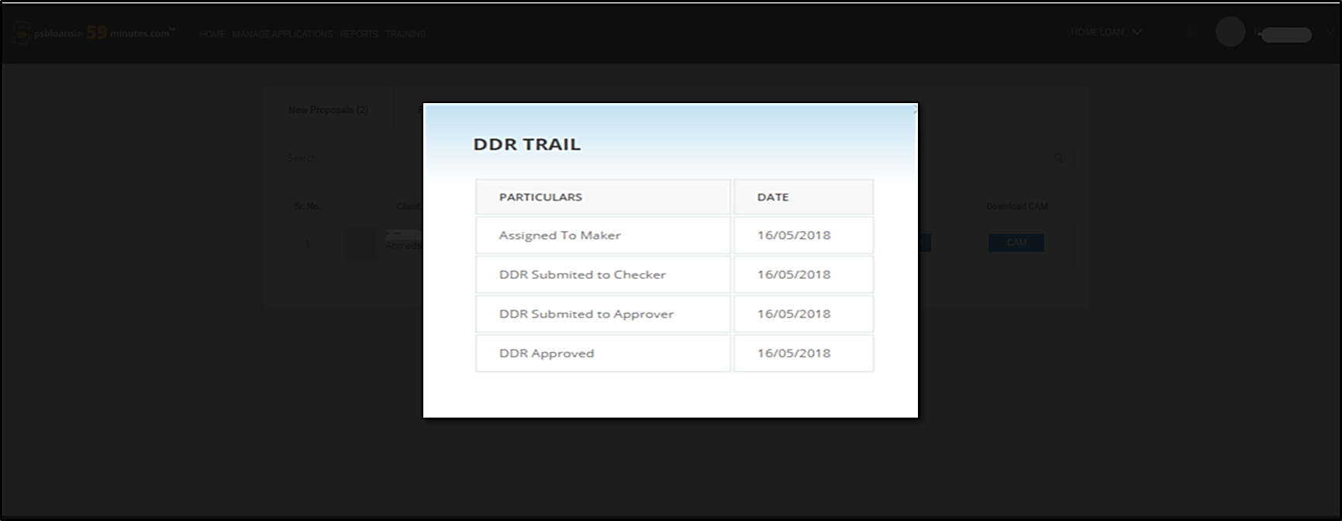
VIEW TRAIL
Once clicked on 'View Trail', the proposal traversal dates are displayed.

Slide 14
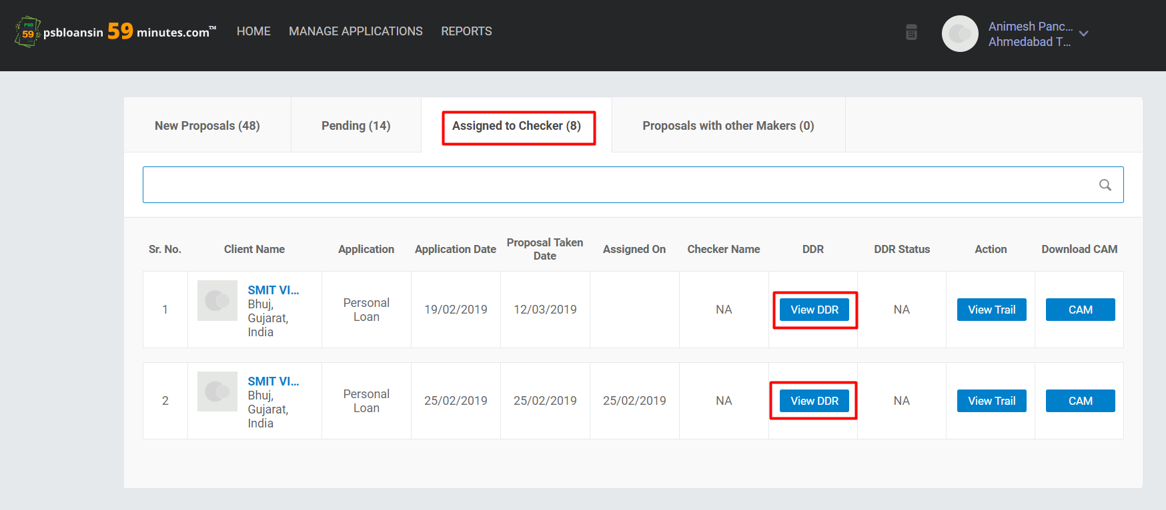
PROPOSAL ASSIGNED TO CHECKER
Borrower
Auto
Loan
Borrower
Auto
Loan
Once the Maker sends the proposal to Checker, the same proposal shifts to the ‘Assigned to Checker’ tab.
Maker can view the Due Diligence Report by clicking on ‘View DDR’ tab.

Slide 15
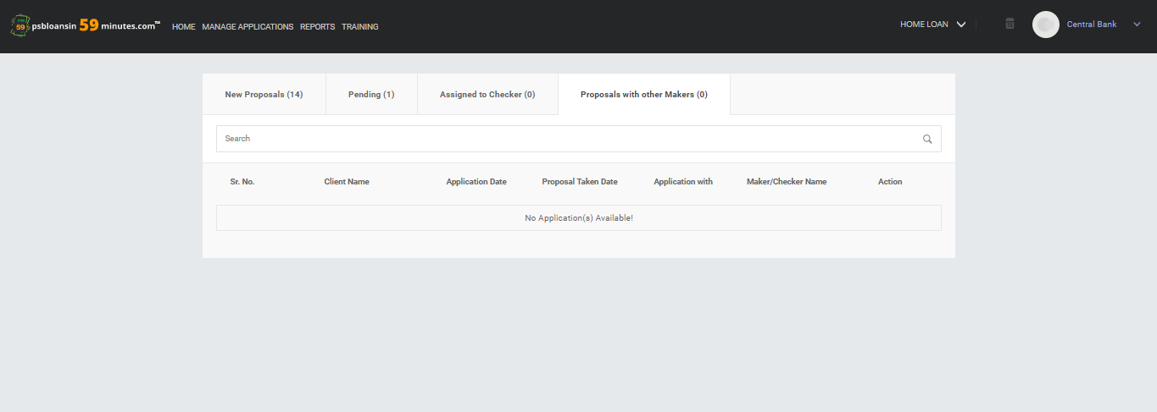
PROPOSALS WITH OTHER MAKERS
Proposals accepted by other Makers are shown under the Proposals with Other Maker Tab.

Slide 16
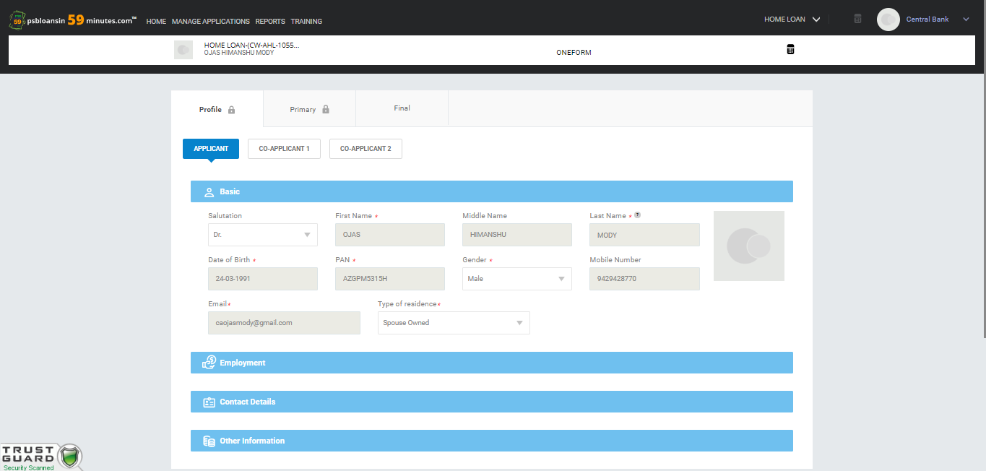
PROFILE/PRIMARY SECTION
AUTO LOAN
Borrower Name
‘Profile’ and ‘Primary’ tabs are auto filled from the In-Principle journey and are hence locked.
The Branch Maker has to click on ‘Final’ tab to fill the final form.

Slide 17
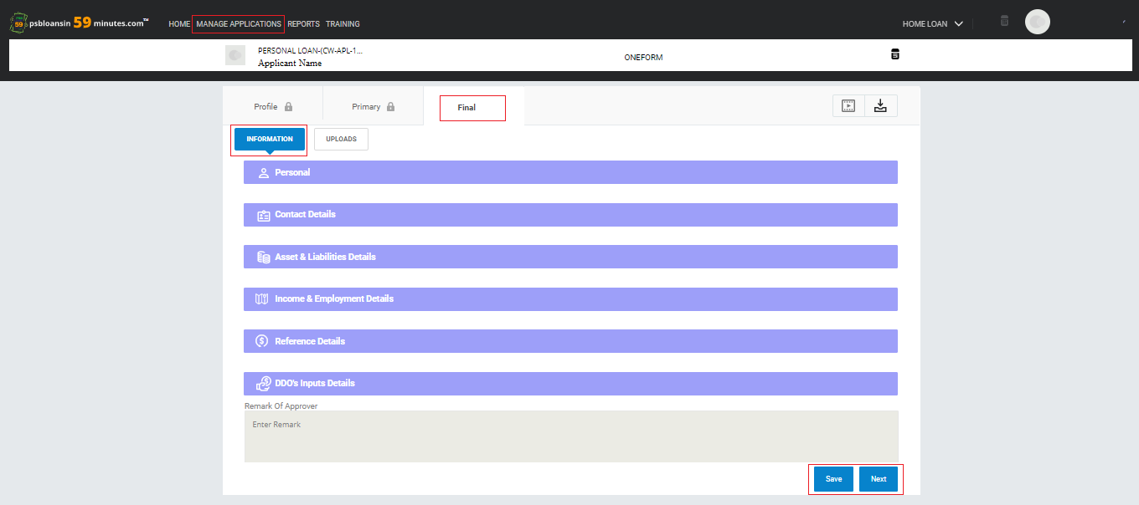
FINAL SECTION - information
AUTO LOAN
Borrower Name
When Maker opens the Final section, the First step is to fill the “Information Section”.
On successfully filling the required information, the Branch Maker can move onto upload the documents collected from the borrowers.

Slide 18
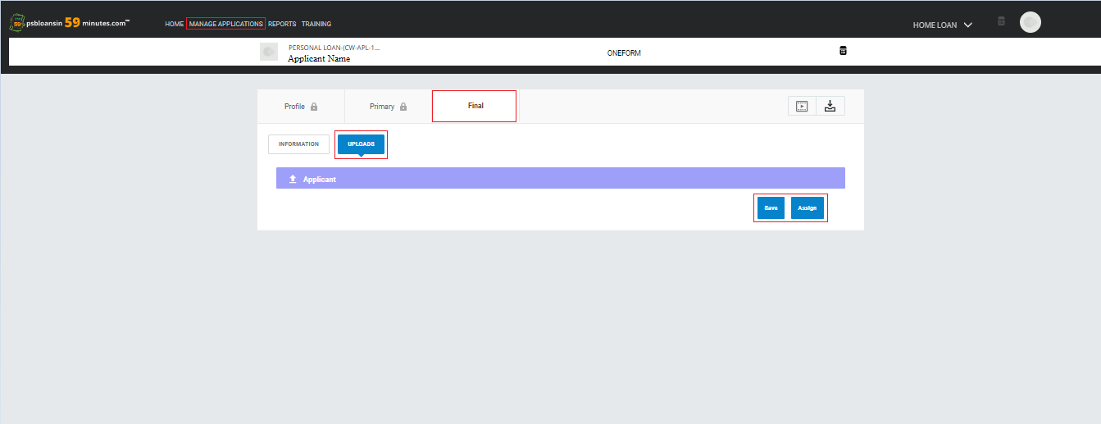
Final section - upload
AUTO LOAN
Borrower Name
Maker can upload documents of the Borrower.
After filling all the details in “Final Section” the maker can click on “Assign” button and assign the proposal to the Branch Checker.

Slide 19
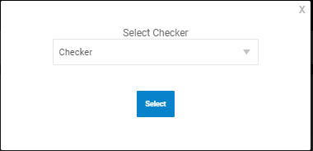
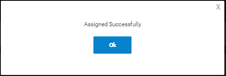
Assign to checker
Select the “Checker Name” to send the DDR for approval. After selecting, a confirmation pop up will be shown and the proposal will be successfully assigned to Branch Checker.

Slide 20
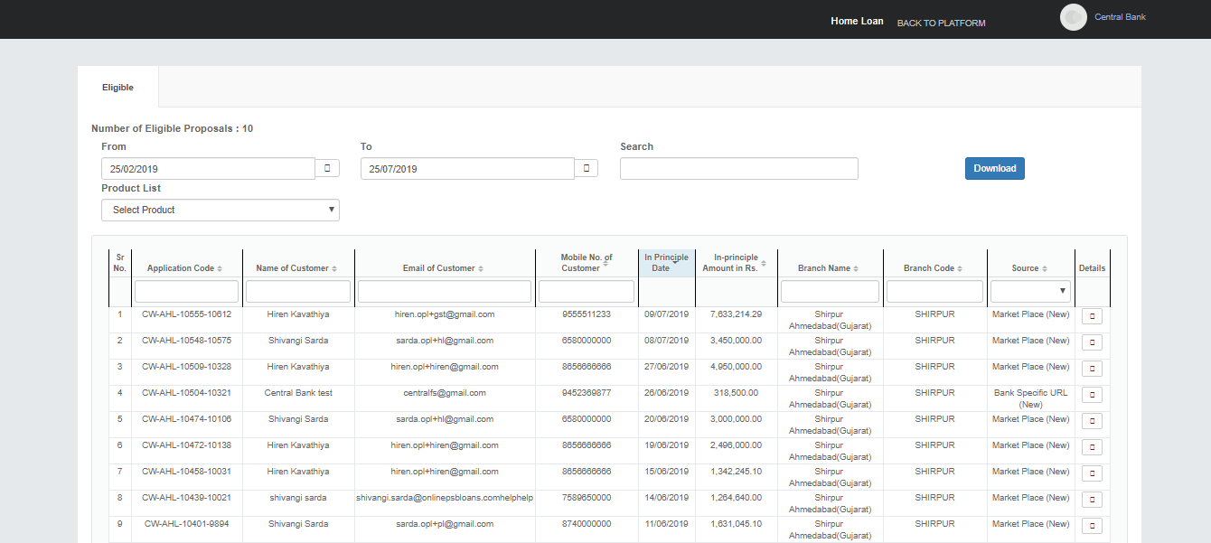
REPORTS
Once the Maker clicks on ‘Reports', he will be able to view all the Eligible Proposals tagged to that Branch.

Slide 21
THANK YOU
Mail us at :
Borrower Journey Queries: support@psbloansin59minutes.com
Banker Journey Queries: banksupport@psbloansin59minutes.com
Customer Helpline No: 079-41055999

